Slide 1


Hackathon 2025
Problem Statement
Optimizing Doctor-Patient Consultations Through Seamless Access and Smart Scheduling, Bridging Healthcare Gaps.

Slide 2

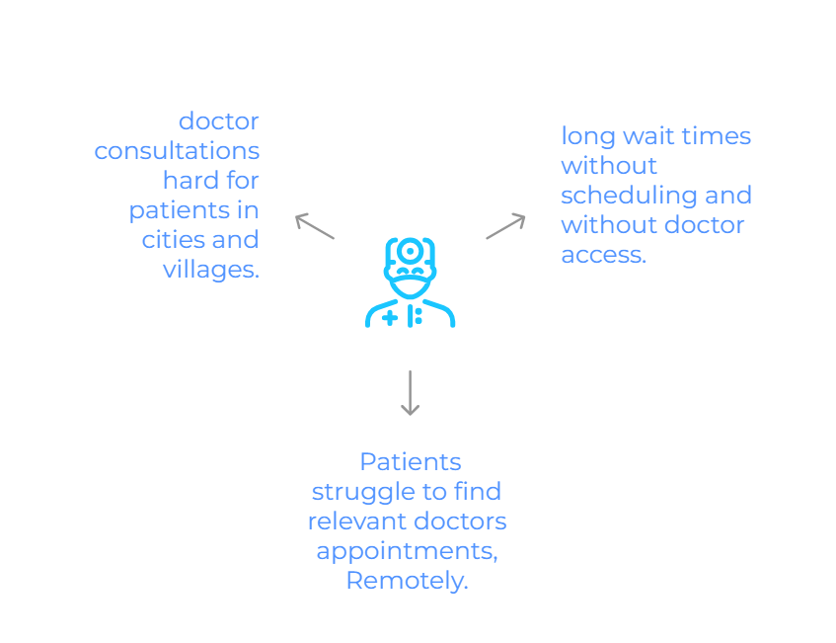

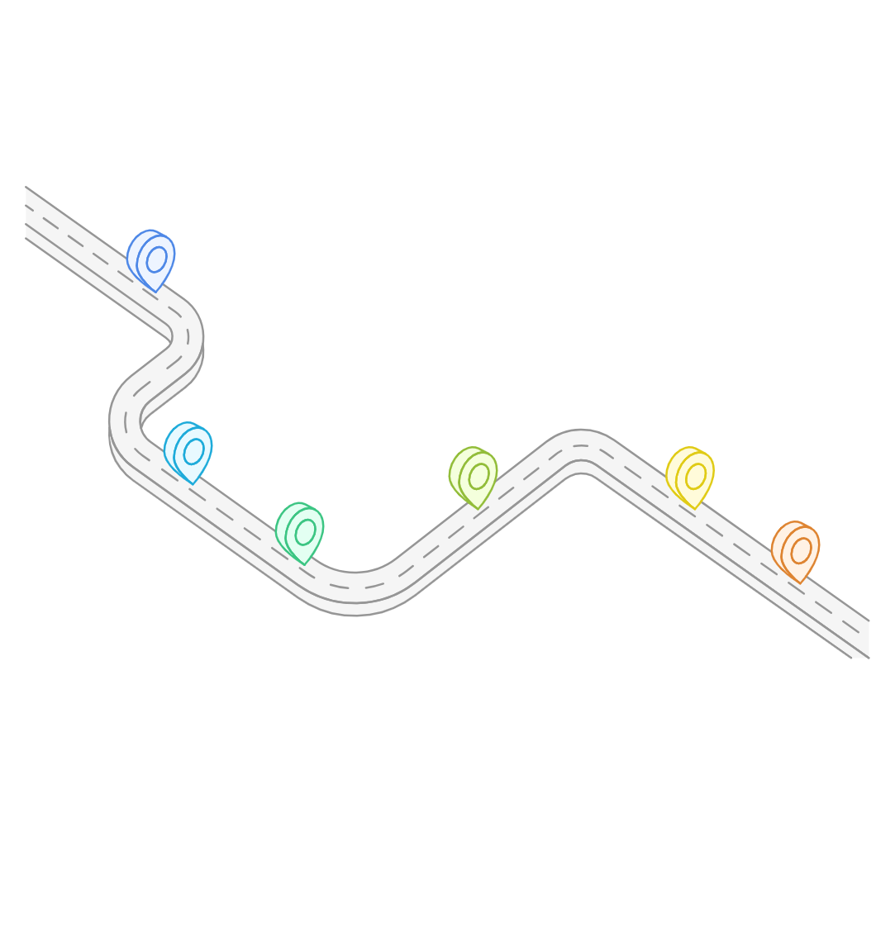
Problem Statement

Slide 3







PROPOSED SOLUTION
Smart Appointment Booking & Scheduling System
Disease Category-Based Doctor Search
No need to travell to booking appointments , zero
transportation
Decrease the waiting hours &
Reduces alot of expences
Accessibility for Small Villages & Remote Areas
Benefits for Hospitals & Patients,
free Mrktng,& Reputaion, patient
satisfaction by good service
Provides Home Laboratory Tests (Lab Tests)

Slide 4
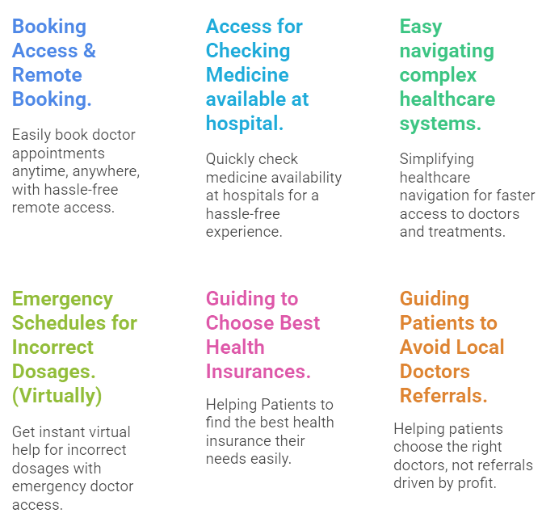

Expansion to Sustain
LONG-TIME SERVICE

Slide 5
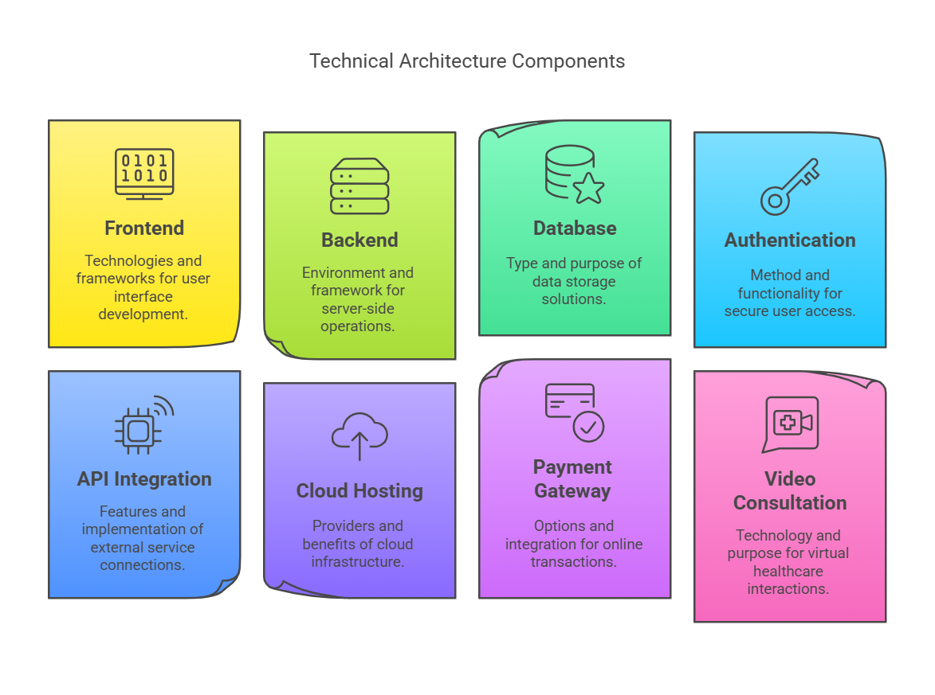



Technical Architechture

Slide 6
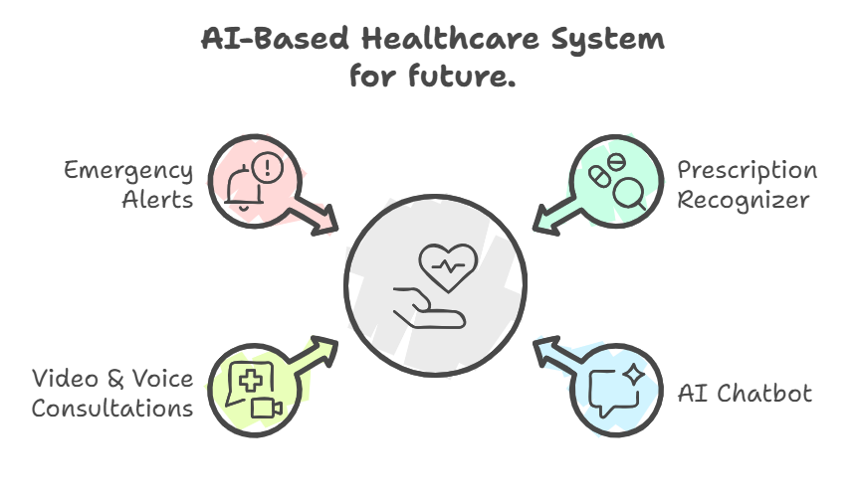
Technical Architechture

Slide 7
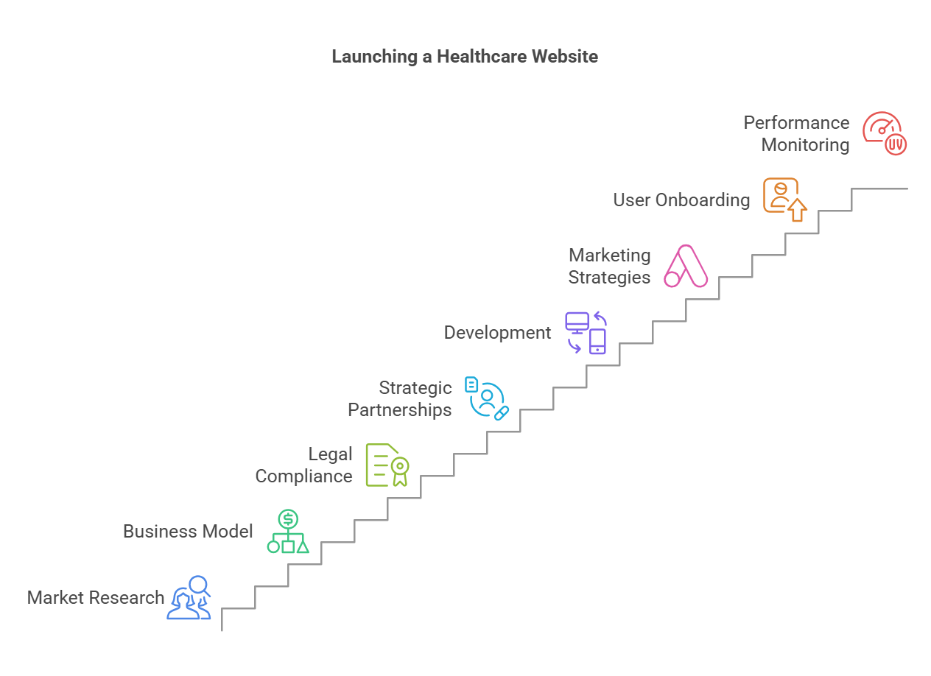




Implementation Plan
Market
& Company Implementation Plan for Website & Product
Launch

Slide 8
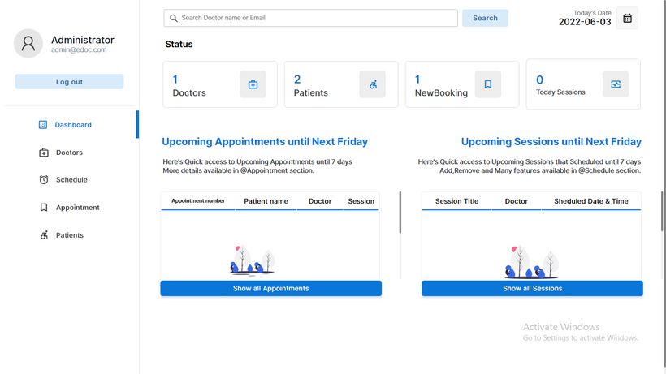
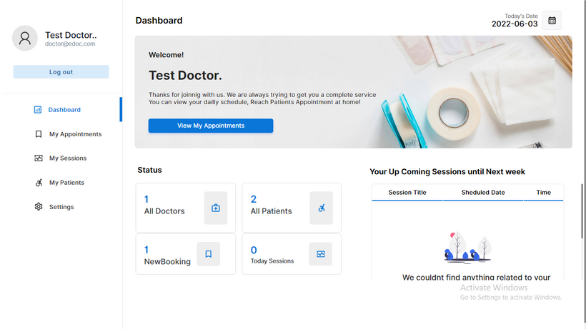
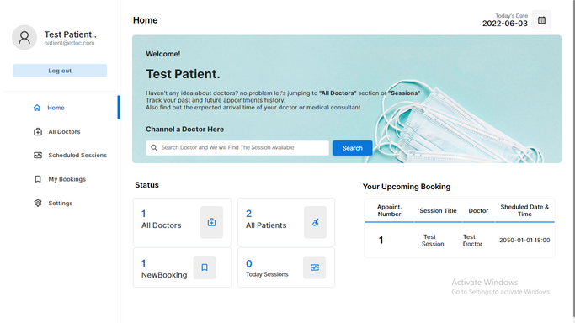
Launching Product in the market
(IMPLEMENTATION PLAN)
Administrator Dashboard
FULL CONTROL OVER SYSTEM, USER MANAGEMENT, HOSPITAL APPROVALS.
Doctor Dashboard
IDENTIFYING PATIENT ISSUES AND FIXING BUGS FOR A SMOOTHER EXPERIENCE, WHERE SERVICE CAN SUSTAIN FOR LONG-TERM.
Patient Dashboard
MANAGE APPOINTMENTS, PATIENT RECORDS, PRESCRIPTIONS, AND AVAILABILITY.
BOOK APPOINTMENTS, VIEW MEDICAL HISTORY, AND ACCESS PRESCRIPTIONS.

Slide 9

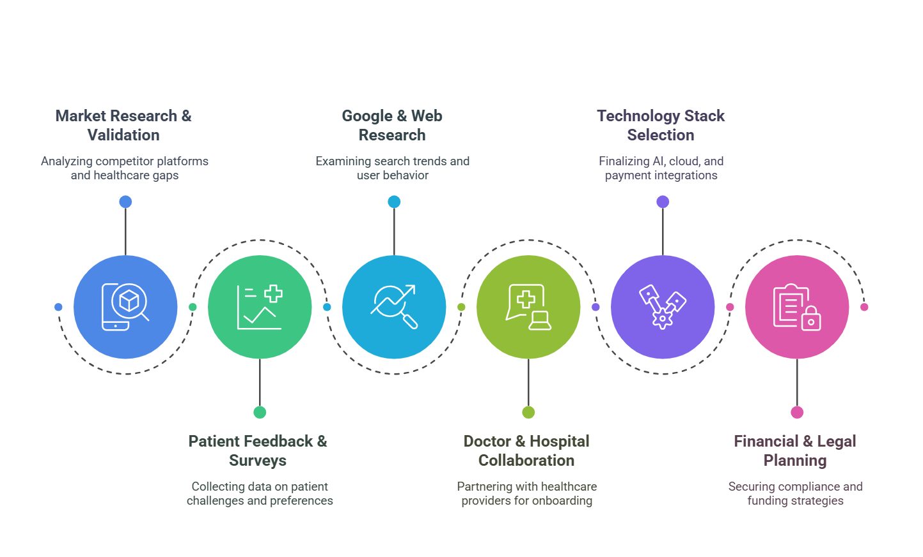


Team and Resource
Rahul Bijjala
Shiva R
Suchitra Tate
Shivart D

Slide 10

Thank
You!
Q&A
Do you have any Queries?

